Slide 1
Pediatric Data Collection System: Requirements and Implementation
SEER*DMS CCAB Meeting; May 2024

Slide 2
Pediatric Data Collection System (PDCS)
PDCS has been developed by the NCI SEER and IMS to support the implementation of Toronto Consensus Principles and Guidelines for Pediatric Cancer Stage in PBCRs
Toronto Principles and Guidelines - endorsed by the IACR, used by IARC, Benchista Project, implemented by multiple PBCRs
The Lancet Oncology 2016;17:e163-72

Slide 3
Pediatric Data Collection System
Developed to collect pediatric staging and site-specific data item (SSDI) information
It is a UICC TNM-based system, follows the Toronto Childhood Cancer Staging Guidelines, Version 2
Consists of:
3 core data items: Pediatric Tumor, Pediatric Regional Nodes, Pediatric Mets
9 new site-specific prognostic factors
4 revised currently collected site-specific prognostic factors
8 derived items
Notes:
I will not take additional time to describe the Pediatric data collection system, but would like to provide a few clarifications. First, as you can see on the slide, if you want to play with the system and get a better sense of the new items, you can do so on the SEER Registrar Staging Assistant website, where you can check all schema definitions, the required data elements of each schema, and the definitions of the pediatric T,N M and prognostic factors. I would like to clarify that this system can be installed by you vendor independent of the EOD,, you do not need to collect EOD in order to collect the pediatric data items. In fact SEER will provide your vendor with all documentation necessary to install the new items. One very direct way you help pediatric research and care is to ask you vendor to install the new items in your system. This does not mean that you will be required to report additional items just because you have the capability. Reporting requirements will be a decision of the central registry director in your state for 2025, but if you want to become familiar and ensure that a 2018 moment will not repeat you can be proactive by asking to have the system installed at your facility.

Slide 4
PDCS and NAACCR Standards
PDCS has been sponsored by NCI SEER Program
Recommended by MLTG for implementation with v24, reconfirmed for v25
Approved by HLSG in March 2024 for implementation in v25
Will be included in the NAACCR Data Standards and Data Dictionary v25
Listed in the Required Status Table as RS* (Required, site specific; when available) for SEER Program
Some vendors and registries implemented/are implementing PDCS in 2024; SEER appreciates the effort of early adopters!

Slide 5
Considerations Regarding PDCS Items
Eligibility based on age
NCCR covers 0-39 for certain schemas, however…
MLTG/HLSG recommended/approved PDCS items for dx. age 0-19
While PIs may use their discretion regarding age-based eligibility
NCI SEER implementation requirements will respect NAACCR standard
(i.e., age 0-19)
Best facility to abstract PDCS for a given case:
Is not necessarily the diagnosing facility
It could be the tertiary care facility providing FCOT
PIs can use their discretion to determine what facilities should abstract PDCS

Slide 6
Focus of PDCS Implementation in 2024-2025
Test the system (technical perspective)
Ensure that hospital vendors become proficient with implementation of new data items using SEER API and DLLs
Real-word validation of schema selection and derivation algorithms
Assess data collection
Completeness of individual items
Feasibility of implementation by facility type (caseload, pediatric oncology services available, etc.)
Train a large mass of registrars to abstract and code PDCS items
Increase general awareness about Toronto Guidelines for Pediatric Staging

Slide 7
SEER Program Expectations Regarding the Selection of Facilities
PIs of SEER Core Registries are expected to select facilities to be involve in PCDS implementation in 2024-2025
Each registry is expected to select at least two facilities (exceptions could be approved by SEER Program Manager)
Facility ID of selected facilities should be communicated to IMS
Registries are encouraged to select more facilities than the required minimum, in particular facilities that provide the first course of treatment (FCOT)
Selection criteria may include:
The average annual caseload of age 0-19 cancer cases
Proportion of cases age 0-19 out of the overall caseload
Proportion of cases age 0-19 that are diagnosed and received FCOT at the facility

Slide 8
Clarification of RS* Requirement
RA* = Required, site-specific; when available
Site-specific refers to the 33 site-specific schemas available in PDCS [see Pediatric Data on SEER*RSA] (do not confuse with EOD or AJCC schemas/chapters)
“When available” recognizes that not all pediatric cases will have abstracts from PDCS-select facilities
CTC-level PDCS data elements are expected when at least one abstract was received from a “selected” facility
All edits correction, consolidation and any other regular QC procedure is expected to be completed for cases with at least one abstract from a select facility
No QC work/no PDCS data required for cases with no abstract from select facilities

Slide 9
Examples Regarding RS* Requirements
Assume facilities A - C have been selected for PDCS implementation, D - Z have not been selected
Case 1 received just one abstract from facility Y; PDCS CTC-level items are not required for submission to SEER
Case 2 received one abstract from facility S and a second from facility B; PDCS CTC-level items are required for submission to SEER
Case 3 received just one abstract from facility C; PDCS CTC-level items are required for submission to SEER

Slide 10
For additional clarifications regarding data collection requirements, please contact: Steve Friedman (friedmast@mail.nih.gov) or Serban Negoita (serban.negoita@nih.gov)

Slide 11
Notes:
I will end my presentation congratulating NCRA and therefore you all for this nice 50th anniversary. For the last 20 minutes I presented our achievements at SEER but almost none of these would have been possible without the support we received from your amazing organization. Thank you NCRA!

Slide 12
PDCS Implementation Plans
Stephanie M. Hill, MPH, ODS-C
Notes:
PDCS = pediatric data collection system.

Slide 13
PDCS Implementation Team
Lead: Stephanie Hill (NAACCR)
Serban Negoita (SEER)
Nicki Schussler (IMS)
Jennifer Ruhl (SEER)

Slide 14
Current API vs PDCS
Current SEER API
EOD, SSDIs
Can stand alone
New PDCS API
Stand alone
No plans to incorporate into AJCC DLL.
Incorporated into the AJCC DLL for hospitals.
No change.
Designed to avoid dual coding for registries implementing both.
Notes:
So software vendors only have to implement the DLL in order to get all the EOD and SSDI fields. That was determined to be an unnecessary step for PDCS API, so vendors will be able to call to the new API separately, although the two are designed to work together to avoid dual-coding for the few data items that

Slide 15
Implementation Strategy
2022/2023 – Beta test in Kentucky - COMPLETE
2024 dx year – Pilot testing in select facilities in SEER states
2025 dx year – Limited implementation in all SEER core registries
2026 dx year – Full implementation in all SEER core registries
TBD – Implementation in all other NCCR registries

Slide 16
2022/2023 Beta Test
Kentucky implemented this change statewide for all relevant cases diagnosed 2023+.
Adding this feature to software was not terribly burdensome, similar to a small-scale annual NAACCR data change
IMS provided an API; it was relatively easy to integrate into the Kentucky Cancer Patient Data Management System.
We chose to isolate the user interface changes to a single form we have for SSDI abstracting, it was minimally disruptive to the abstracting workflow.
Most pediatric cancer cases in the state are seen at our two largest facilities, so the changes to abstracting workload were not felt widely across the state. We did not receive negative feedback from any facilities about this change.
Training for abstractors across the state by KCR staff was not particularly difficult

Slide 17
2024 Pilot Testing
Engaged with 3 hospital registry software vendors
3 hospitals across 2 SEER registries
Special XML data dictionary extension
Separate edits metafile
Included in SEER*DMS
Targeted training
Notes:
At various stages of engaging with 3 hospital registry software vendors: C/NET, Elekta, Oncolog
C/NET plans to include it in the July/August v24 update for selected facilities (LTR, Seattle)
Not part of v24 NAACCR data dictionary, so a special data dictionary extension is being provided to vendors implementing before v25.

Slide 18
2025 Implementation
PDCS elements included in v25 NAACCR Data Dictionary and edits metafile.
SEER PIs each select 2 facilities for implementation.
PDCS Implementation Team will coordinate with central registries, vendors, and facilities.
Follows implementation timeline established by MLTG

Slide 19
SEER Registry PI Responsibilities
Select 2* facilities in your state to implement PDCS in 2025 (by August 1, 2024)
Communicate with registry lead(s) at selected facilities.
Notify PDCS Implementation Team of selected facilities.
Facility Name
Registry contact
Registry software vendor

Slide 20
Facility Selection
Suggested criteria:
Pediatric case volume
Software vendor
Registry contacts/relationship
Involvement in NAACCR Peds SSDI WG (TX, NY)
Notes:
Representatives on Peds SSDI WG
TX – Texas Children’s Hospital
TX – John Peter Smith Hospital
NY – MSKCC

Slide 21
Timeline
July–Aug. 2024
C/NET Pilot Testing begins
1 Aug. 2024
PIs notify SEER/NAACCR of selected registries.
Aug. 2024
Mid-August 2024 – NAACCR v25 vendor meeting.
Sep. 2024
Mid-September 2024 – Kick-off meeting for selected hospital registries.
1 Oct. 2024
Notify hospital registry vendors.
Nov.–Dec. 2024
NAACCR training webinars
1 Jan. – 30 June 2025
API included in hospital software updates

Slide 22
Implementation Products
XML Data Dictionary Extension (2024 only) – available by request
NAACCR v25 Data Standards & Data Dictionary
API/DLL
Edits metafile

Slide 23
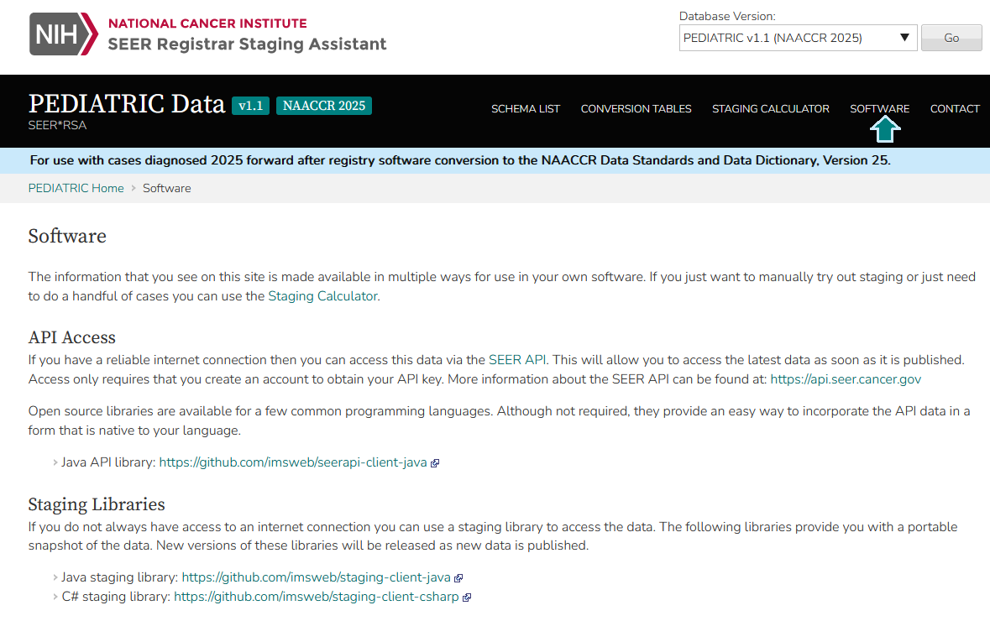
Links to SEER Staging API for PDCS
https://staging.seer.cancer.gov/
pediatric/software/1.1/
Select ‘View Pediatric Data (2024+)’ on SEER*RSA
Select ‘SOFTWARE’ in upper right

Slide 24
Training
SEER Advanced Coding Workshop – September 2024
NAACCR v25 webinars (live & recorded) – November/December 2025
NCRA annual meeting – May 2025
Ask a SEER Registrar subject area

Slide 25
Questions?

